Slide 1


– Intensive Week
Case presentation
March 17, 2025

Slide 2
Table of contents
Section 1 Case – overview 2
Section 2 Background 5
Section 3 Exposure at Default 9
Section 4 PD & LGD 14
Section 5 Financial derivatives 17
Section 6 Input data 21
Section 7 Timeline proposal 24
Section 8 Grading 26

Slide 3
Section 1
Case – overview

Slide 4
Case
Overview
Calculate Risk Weighted Assets for the Bank using the Internal Model approach for three counterparties (Salzburg Bank, Bank of Cluj, Bank of Mazowsze) as of 29th February 2024. Assume notional for all the trades is 1.000.000.000 USD.
Portfolios:
Salzburg Bank (ID = 484)(netted) :
1y Call Option on SPDRM striked at 95 USD
Bank of Cluj (ID = 47)(non netted):
6m Call Asian Option on IRNMN striked at 570 USD
Bank of Mazowsze (ID = 2741)(netted):
1.5y Call American Option on AVNG striked at 4100 USD
2y Put Option on SPDRM striked at 115 USD
1.5y Put Asian Option on IRNMN striked at 450 USD
9m Put Asian Option on AVNG striked at 4100 USD
* Any relations to the real tickers is purely coincidental

Slide 5
Case
Data Files
To solve the problem you need to make use of the following data:
Market data
https://github.com/INTQuant-Katowice/2025/blob/master/Data/Market%20Data.xlsx
Counterparty defaults
https://github.com/INTQuant-Katowice/2025/blob/master/Data/DataPD.txt
For calibration of the interest rate model for EAD calculation
For PD model calibration

Slide 6
Section 2
Background

Slide 7

Tools
The choice of tools is entirely yours. We would like to focus on methodology aspects rather than technicalities.
The examples of tools: Python, R, Mathlab, Excel, C++,
abacus, tossing a coin, and many more.
…however…
We recommend writing code in python
It’s interpreted, high-level, general purpose, has large online community for support.
It is very popular in the industry.
We are offering some introductory course
Introduction to Python (Tuesday at 10:00)
in preparation: please install Anaconda (https://www.anaconda.com/)
Example of neat code editor: Visual Studio Code (https://code.visualstudio.com/)

Slide 8
Overview
Why is the industry regulated?
“. . . Regulations are like guardrails, they protect everyone from market excess . . .”
David Silberman, CFPB
“It sometimes seems like our financial system is set up to penalize those who know the least and have the least . . . It appears to me that the system has gone beyond beware to buyer be damned.”
Richard Cordray, Director of CFPB
Focus points
Capital
Supervision
Governance
Liquidity
Systemic risk
Culture and Conduct
To help manage the project: Introduction to Agile Project Managment (Wednesday at 10:00)

Slide 9
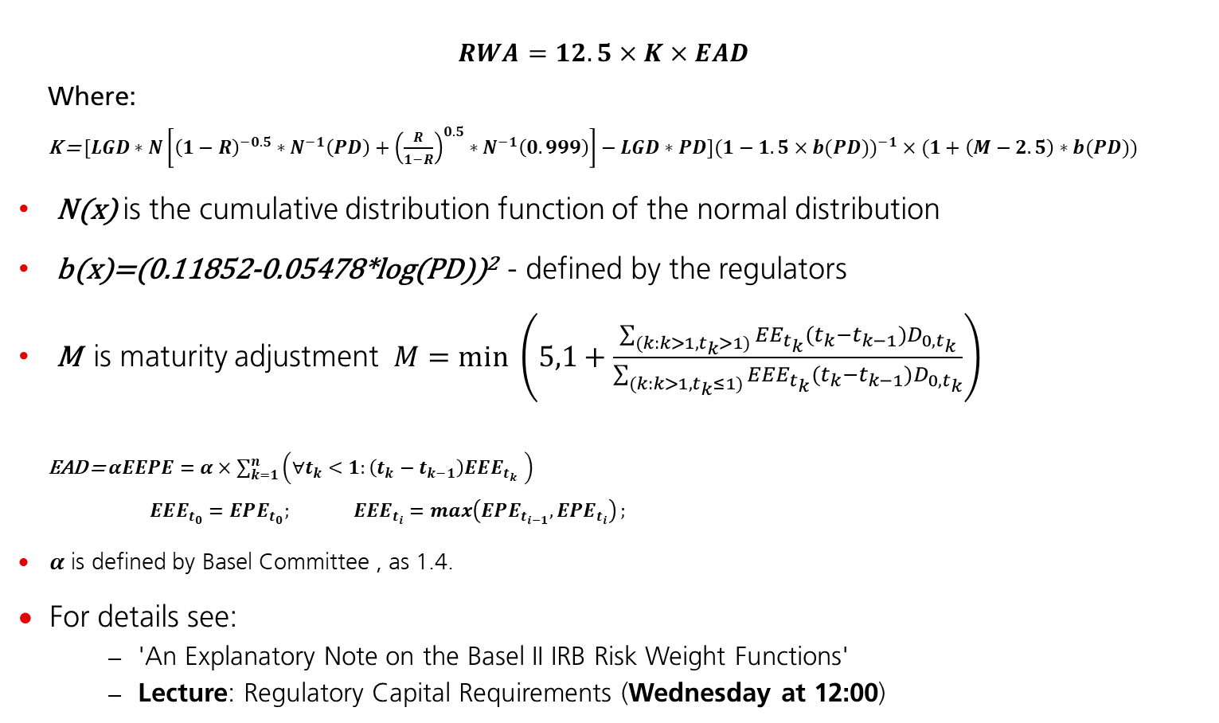
Overview
How to calculate it?
EEE – Effective Expected Exposure
EEPE – Effective Expected Positive Exposure
$$RWA=12.5×K×EAD$$
Where:
K = $[LGD∗N\left[{\left(1−R\right)}^{−0.5}∗N^{−1}\left(PD\right)+{\left(\frac{R}{1−R}\right)}^{0.5}∗N^{−1}\left(0.999\right)\right]−LGD∗PD]({1−1.5×b(PD))}^{−1}×(1+\left(M−2.5\right)∗b(PD))$
N(x) is the cumulative distribution function of the normal distribution
b(x)=(0.11852-0.05478*log(PD))² - defined by the regulators
M is maturity adjustment $M=min \left.\left(5,1+\frac{\sum_{(k:k>1,t_{k}>1)}{EE_{t_{k}}(t_{k}−t_{k−1})D_{0,t_{k}}}}{\sum_{(k:k>1, t_{k}≤1)}{EEE_{t_{k}}(t_{k}−t_{k−1})D_{0,t_{k}}}}\right.\right)$
EAD = $αEEPE=α×\sum_{k=1}^{n}{\left.\left(∀t_{k}<1:\left(t_{k}−t_{k−1}\right)EEE_{t_{k }}\right.\right)}$
$EEE_{t_{0}}=EPE_{t_{0}}; EEE_{t_{i}}=\max\left(EPE_{t_{i−1}},{EPE}_{t_{i}}\right);$
$α$ is defined by Basel Committee , as 1.4.
For details see:
'An Explanatory Note on the Basel II IRB Risk Weight Functions'
Lecture: Regulatory Capital Requirements (Wednesday at 12:00)
Asset Correlation – assume 0.2 in your calculation
Discounting

Slide 10
Credit Regulatory Capital (RWA)
How to calculate it?
Expected Exposure (EE)
The amount of money that the counterparty owes UBS at the time of default event
In case of traded derivatives it requires the usage of underlying market risk factor models.
The most popular approach is simulation of market risk factor using Monte Carlo technique
For simple products under simple models there exist closed form solutions (e.g. Black Scholes model)
Creditworthiness
Probability of Default (PD)
The probability of the counterparty default in a given time period
Estimated using statistical modelling based on historical defaults
Loss Given Default (LGD)
Fraction of the total EAD that is lost

Slide 11
Section 3
Exposure at Default

Slide 12
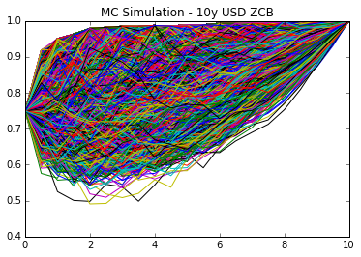
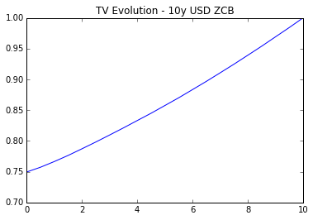
Risk Factor Simulation
Short rate modelling
We can employ MC simulation to model the evolution of stock price thru time:
SDE:
dS = μSdt + σ(t) S dZ
In S's SDE, there is only one source of uncertainty. This is called a one factor model;
(For simple products [e.g. options] a closed form approach could be used)
More info: Modeling Equity Prices (Tuesday at 10:00)
More info: Introduction to MC Simulation in Finance (Tuesday at 14:00)

Slide 13
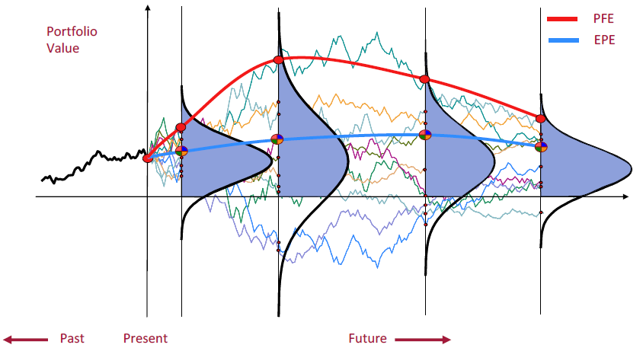
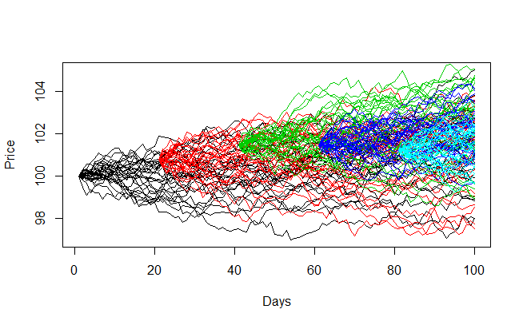
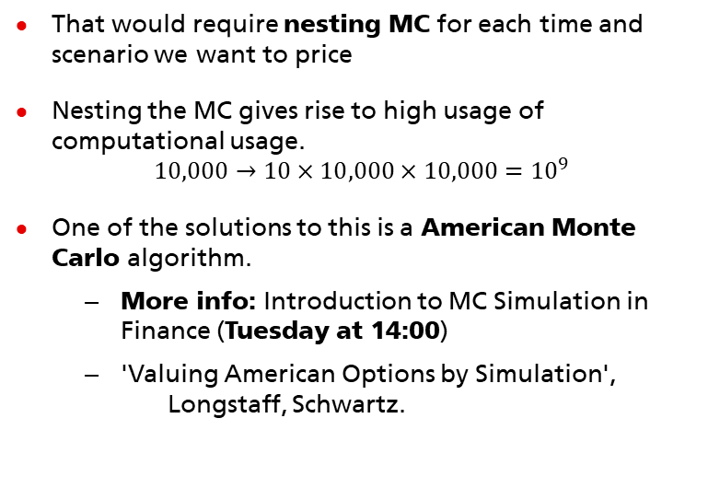
Calculating Risk Profiles
Simulation is not enough!
Simulation would give you only a Day 0 TV
Calculating RWA requires knowledge of TV distribution at each point in time
MC simulation can provide very general solution to problem of pricing a derivatives regardless of it's complexity
For consistency we need to treat portfolio as a whole, which force us to price trades on scenario by scenario
Issue: scenario consistency
That would require nesting MC for each time and scenario we want to price
Nesting the MC gives rise to high usage of computational usage.
$$10,000→10×10,000×10,000={10}^{9}$$
One of the solutions to this is a American Monte Carlo algorithm.
More info: Introduction to MC Simulation in Finance (Tuesday at 14:00)
'Valuing American Options by Simulation', Longstaff, Schwartz.

Slide 14
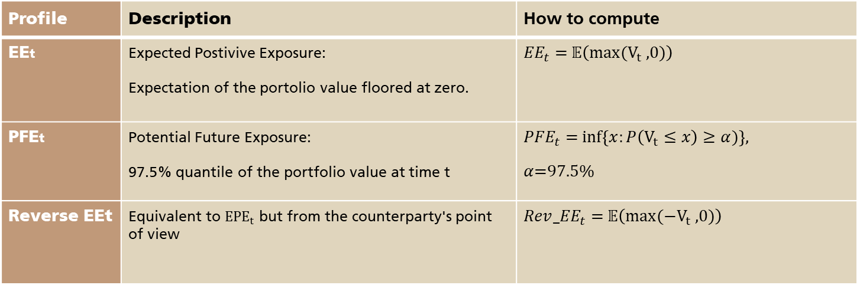
Calculating Risk Profiles
Risk measures definitions
Profile | Description | How to compute
EEt | Expected Postivive Exposure: Expectation of the portolio value floored at zero. | ${EE}_{t}$ = $𝔼\left(max⁡(V_{t} \text{,0)}\right)$
PFEt | Potential Future Exposure: 97.5% quantile of the portfolio value at time t | ${PFE}_{t}$ = $inf\left\{x:P\left(V_{t}≤x\right)≥α)\right\}$, $α$=97.5%
Reverse EEt | Equivalent to ${EPE}_{t}$ but from the counterparty's point of view | ${Rev_EE}_{t}$ = $𝔼\left(max⁡(−V_{t} \text{,0)}\right)$

Slide 15
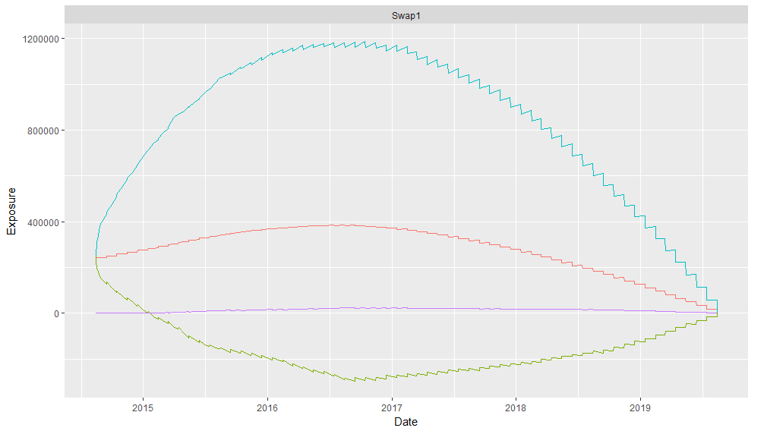
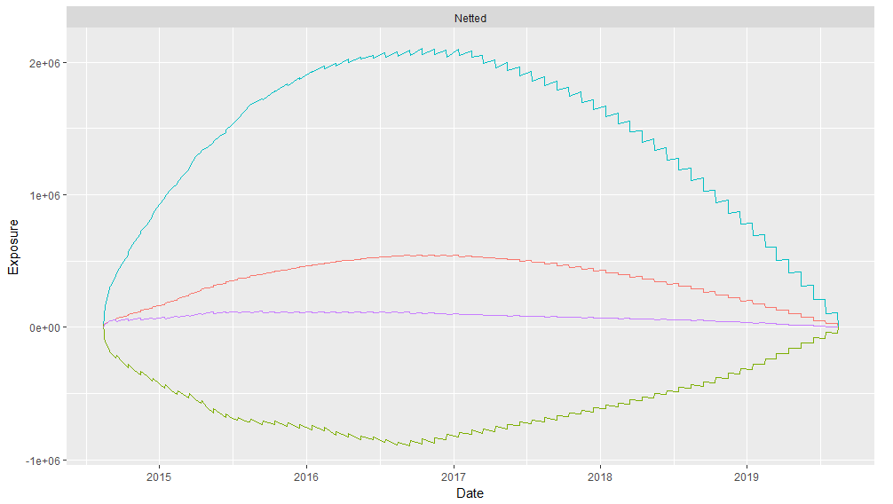
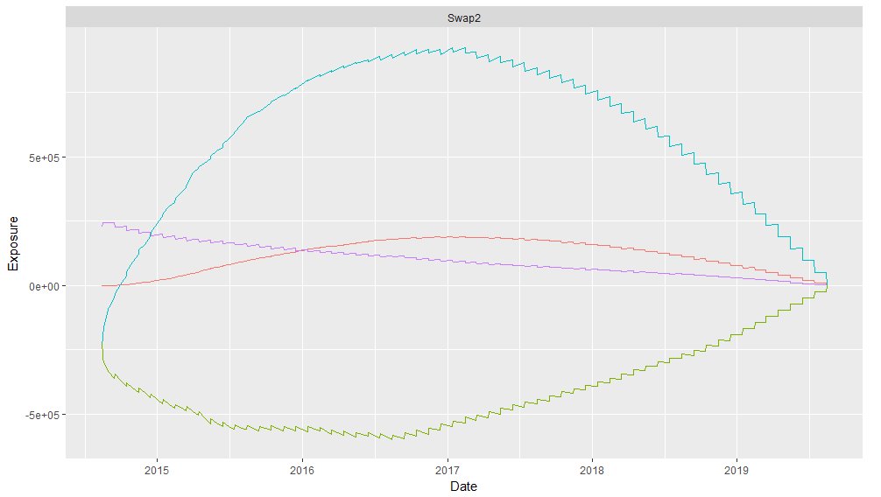
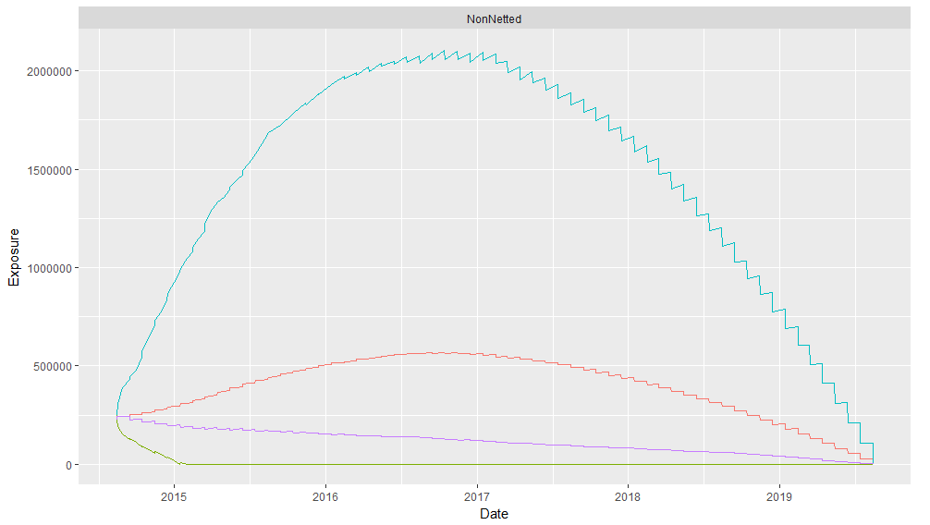
Netted vs Nonnetted
Brief overview
Banks often have more then one active trade with a counterparty.
Two options to aggregate risk profiles:
Netting – calculated values of all trades for each scenarios (simulation paths) are added separately. Path by path aggregation
No netting – aggregated risk measures are sum of risk measures for specific trades
Trade 1
Netted
Path by path
+
Trade 2
Sum of measures
NonNetted

Slide 16

Expectation
What we would like to see?
Present following risk profiles:
Quantile 97.5%
Quantile 2.5%
Expected Exposure
Reverse Expected Exposure
At different levels of aggregation:
Trade level
Portfolio level
Firmwide
Tests
Option pricing

Slide 17
Section 4
PD & LGD

Slide 18
LGD&PD
A brief overview
Loss Given Default:
The amount of historical data on LGD is usually substantially less than for PD
This enables the company's to sometimes fall-back to expert judgment approach
Assume some number based on the situation in the given industry/country
Either use the most conservative value possible (100%) – all is lost.
In this exercise we assume LGD is 60% for all the counterparties
Probability of Default:
Considered time horizon is one year
Usually bucketed into ratings (AAA, BB+, etc.)
Depends both on obligor - specific factors (e.g. equity to assets, revenue growth) and macroeconomic conditions (e.g. unemployment rate, GDP growth)
From statistical point of view PD is an estimator of default rate (share of defaulted counterparties over all observations), usually modelled via GLM models (logit, probit regressions)
Statistical models serves a support for Credit Officers responsible for credit condition assessment
More info: Credit Risk Fundamentals (Wednseday at 12:00)

Slide 19
Expectation
What we would like to see?
Expert judgement on LGD
Build a PD model
Understand strengths and weaknesses of chosen approach
Check the model performance relying on provided data
Use created model to assess credit rating of selected counterparties

Slide 20
Section 5
Financial derivatives

Slide 21
Financial Derivatives
What is it?
Asian Option
American option
European Option
The European Call Option gives the holder the right to buy the asset at a predetermined price K and at a predetermined time T.
The European Put Option gives the holder the right to sell the asset at a predetermined price K and at a predetermined time T.
Payoff is determined by the average underlying price over some period of time
Can be exercised at any time before maturity T

Slide 22
Section 6
Input data

Slide 23
Market Data
Option Prices | Tenors between 3m and 2y Given across 4 strikes Needed for Black Sholes model calibration Modeling Equity Prices (Monday at 11:15)
Strike (K) | T = 3/12 | T = 6/12 | T = 1 | T = 2
3800 | 390.11 | 533.89 | 772.02 | 1137.69
4000 | 263.32 | 418.41 | 629.96 | 949.82
4200 | 168.86 | 307.22 | 510.59 | 823.7
4500 | 77.04 | 182.42 | 365.85 | 687.14

Slide 24
Counterparty default data (PD)
Composition of default data
Data table contains 26 annual financial statements for Developed Market Banks together with default indicator
Data covers period 2000 – 2014
Usually for confidentiality reasons additional information like counterparty name, statement date or domicile are not present in the dataset
Data contains outliers and missing values what is an additional model development challenge
Simulated data, tab delimited
The detail description of the variables in the file: https://github.com/INTQuant-Katowice/2025/blob/master/Data/Description.txt

Slide 25
Section 7
Timeline proposal

Slide 26
Timeline proposal
Only a suggestion
PD
EAD
Wednesday 13
Initial model fitted to the data
Thursday 14
Choose a specific model as a basis for Friday's Q&A session
Monday 18
Final model chosen, assessed and PD assigned
Friday 15
Having dealt with outliers and NAs in the data
Wednesday 13
Equity model chosen
Friday 15
Pricing vanilla/asian options
Monday 18
Initial trades profiles produced
Wednesday 20
Aggregation of single profiles
Pricing american options

Slide 27
Section 8
Grading

Slide 28
Grading
Most important things to have in mind
The most important thing is that the exercise is completed.
The simplest and working > Fancy and failing
Fancy and working > simple and working
Milestones
EAD
Able to properly price options
Able to properly price american options
Able to extract sensible risk profile for single trade
Able to aggregate on various level
PD
Assess the PD model (visualizations and fit quality measures)
Motivate decision to go for a given specification
Assign a PD to each counterparty
Extract PDs of the three counterparties that are in the scope of EAD part
Apply regulatory formula to calculate RWA
RWA

Slide 29
Reports
Most important things to have in mind
Written reports:
10-15 pages (including pictures, graphs cover page, etc.)
Focus: methodology and testing mostly. Implementation details are of low importance.
Presentation:
30 min per team (20-25 min presentations + 5-10 mins questions)
Given the length no more than 25 slides needed.
Deadline: Thursday 21st March 2024 5PM

Slide 30

Contact information
What to do in case of problems?
Each team is allowed to ask one Question a day by an email.
The first Q&A session is on Friday only until then it is the only thing that let’s you have an early feedback!
Sent the questions to: lecturer
Be mindful to formulate your question properly to pinpoint the core of the problem
Questions like: 'Why it is not working?' will be answered with 'Because you are doing something wrong.'
Make the questions methodology oriented not implementation oriented.
Online conferences calls
We will try to split time equally among all the teams
Friday March 21 at 12:00+ Monday March 24 at 12:00+ Wednesday March 27 at 12:00
The session will be open for all teams
Try to explore and narrow down the problems before asking about them as we might not have enough time to engage into detailed discussions
Be sure to start the subject with phrase: INTQuant Question – Day X
www.ubs.com

Slide 31
Thank You
Good luck!
Questions?

Slide 32
Appendix: Bonus Portfolio
Was exercise too easy?
What to do if you get the exercise done before the deadline?
Play table tennis,
Beer,
Visit all the pubs in Katowice,
Get more points by calculating RWA for additional portfolio.
Portfolio of Bank of Siena (ID: 61) (netted):
2y Call American Option on AVNG striked at 4150 USD
Few tricks:
Simulating two tickers at once would require to make use of set of correlated brownians. Assume correlation of 80%
Play Board games,
1y Put Asian Option on IRNMN striked at 460 USD

